Slide 1
MDX Fundamentals
25th March 2015

Slide 2
Prerequisite
OLAP Concepts
SQL
SSAS

Slide 3
One-Dimensional Data
What is the value at position 3?
10
Tushar
15
67
Joe

Slide 4
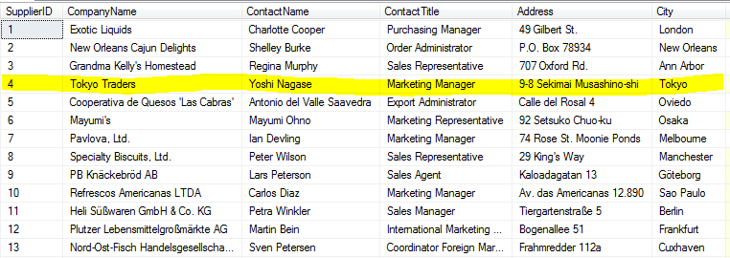
Two dimensional data
Two dimensional data is what is stored in relational systems
What is City for supplied 4?

Slide 5
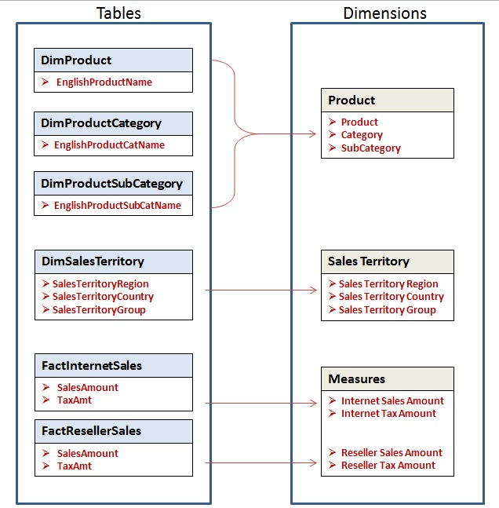
How is a relational database different from a cube?
This figure shows a simple but exact mapping of how some five tables in the AdventureWorksDW
relational database are represented as dimensions in the Adventure Works cube, with the exact names used in both environments.
We can also see how the columns in the tables are represented as attributes in the cube.

Slide 6
MDX
Multidimensional Expressions (MDX) is a query language for OLAP databases, much like SQL is a query language for relational databases. It is also a calculation language, with syntax similar to spread sheet formulas.
Multidimensional Expressions (MDX) lets you query multidimensional objects, such as cubes, and return multidimensional cellsets that contain the cube's data.
Let's start by outlining one of the simplest forms of an MDX expression, bearing in mind this is for an outline of an expression returning two cube dimensions:
SELECT axis specification ON COLUMNS,
axis specification ON ROWS
FROM cube_name
WHERE slicer_specification

Slide 7
SQL vs. MDX
let’s say we want to retrieve the Internet Sales Amount. In the database that will be the column SalesAmount in theFactInternetSales table, and in the cube that will be InternetSaleAmount attribute in the Measures dimension.
The first major difference to note is that in MDX even though the SELECT list are derived from dimensions, the FROM clause is not on the dimension but on the cube, unlike in SQL where the FROM clause is directly on tables.
SQL:
SELECT [Table].[ColumnName]
FROM [Table]
MDX:
SELECT [Dimension].[AttributeName]
FROM [Cube]
SQL:
SELECT [FactInternetSales].[SalesAmount]
FROM [FactInternetSales]
MDX:
SELECT [Measures].[InternetSalesAmount]
FROM [Adventure Works]

Slide 8
MDX Queries axis specification
SELECT
[Measures].[Internet Sales Amount] ON COLUMNS
,[Product].[Product] ON ROWS
FROM [Adventure Works]
OR
SELECT
[Measures].[Internet Sales Amount] ON Axis(0)
,[Product].[Product] ON Axis(1)
FROM [Adventure Works]
OR
SELECT
[Measures].[Internet Sales Amount] ON 0
,[Product].[Product] ON 1
FROM [Adventure Works]

Slide 9
Skipping axis
Remember that you cannot skip axis, in other words you cannot display on axis(1) displaying on axis(0) first. If you don’t want to display anything on axis you can display an empty set { } as below.
SELECT
{} ON ROWS
, [Product].[Product].[Product] ON COLUMNS
FROM [Adventure Works]

Slide 10
SQL vs. MDX - Joins
difference between SQL and MDX is the fact that unlike SQL, MDX does not need to explicitly join dimensions using the "JOIN" word when pulling data from multiple dimensions.
You always select FROM the cube and the cube does all the Joining for you.
SQL:
SELECT
[DimSalesTerritory].[SalesTerritoryRegion]
,[FactInternetSales].[SalesAmount]
FROM FactInternetSales
INNER JOIN DimSalesTerritory
ON FactInternetSales.SalesTerritoryKey = DimSalesTerritory.SalesTerritoryKey
MDX:
SELECT
[Measures].[Internet Sales Amount] ON COLUMNS
,[Sales Territory].[Sales Territory Region].[Sales Territory Region] ON ROWS
FROM [Adventure Works]

Slide 11
Aggregation and "GROUP BY" Clause
MDX by default always implicitly aggregates the attributes in the Measures dimension (in this case Internet Sales Amount) and implicitly group the result by any other Dimensional Attribute in the SELECT list. The aggregation function it applies (in this case "SUM") is defined at design time.
On the other hand SQL will return detail records unless you explicitly tell it to aggregate the data by including a specific aggregate function and the Group By clause.
SQL:
SELECT
Sum([FactInternetSales].[SalesAmount]) as SalesAmount ,[DimSalesTerritory].[SalesTerritoryRegion]
FROM FactInternetSales INNER JOIN DimSalesTerritory
ON FactInternetSales.SalesTerritoryKey = DimSalesTerritory.SalesTerritoryKey
GROUP BY [DimSalesTerritory].[SalesTerritoryRegion]
MDX:
SELECT
[Measures].[Internet Sales Amount] ON COLUMNS
,[Sales Territory].[Sales Territory Region].[Sales Territory Region] ON ROWS
FROM [Adventure Works]

Slide 12
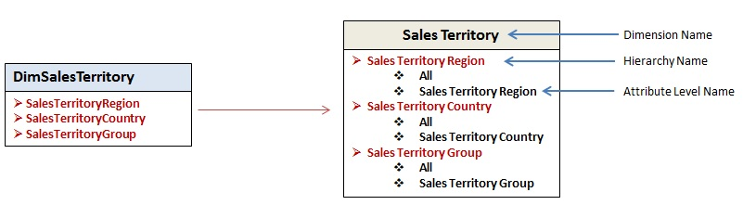
Attribute Hierarchies (1/2)
Why we repeated the name of the SalesTerritoryRegion Attribute like this [Sales Territory Region].[Sales Territory Region] in previous query ?.
By default the cube actually creates a hierarchy out of each attribute that is mapped into a Regular dimension.
Figure above shows a drill down of each of the attribute in the Sales Territory dimension displaying the two-level hierarchy under each attribute.
Each attribute hierarchy consists of a top level member called "All" and an Attribute level (with the same name as the name of the attribute hierarchy) below it.
To navigate to each attribute level in order to display all detail level data, you have to navigate to the dimension, the Attribute Hierarchy and then the attribute level, all by name as shown below.
[<Dimension Name>].[<Hierarchy Name>].[<Level Name>]

Slide 13
MDX Slicer Specification
SQL:
SELECT sum(dbo.FactInternetSales.SalesAmount) as InternetSalesAmount
FROM dbo.FactInternetSales
INNER JOIN dbo.DimSalesTerritory
ON dbo.FactInternetSales.SalesTerritoryKey = dbo.DimSalesTerritory.SalesTerritoryKey
WHERE dbo.DimSalesTerritory.SalesTerritoryGroup='Europe‘
MDX:
SELECT
[Measures].[Internet Sales Amount] ON COLUMNS
FROM [Adventure Works] WHERE [Sales Territory].[Sales Territory Group].[Europe]
SELECT
[Measures].[Internet Sales Amount] ON COLUMNS
,[Sales Territory].[Sales Territory Group].[Europe] ON ROWS
FROM [Adventure Works] WHERE [Sales Territory].[Sales Territory Group].[Europe]
The Problem is that, In MDX the dimension on the WHERE clause acts as what is called a “slicer dimension”. In other words they are dimensions that are not explicitly assigned to an axis and so MDX sees it as repeating SalesTerritoryGroup dimension attribute.

Slide 14
The “HAVING” Clause
Note that unlike the "WHERE" clause, the "HAVING" clause is treated as an actual filter in MDX. But unlike the WHERE clause it is used to filter the contents of an axis based on defined criteria.
SQL:
SELECT
[DimSalesTerritory].[SalesTerritoryGroup]
,Sum([FactInternetSales].[SalesAmount]) as SalesAmount
FROM FactInternetSales
INNER JOIN DimSalesTerritory
ON FactInternetSales.SalesTerritoryKey = DimSalesTerritory.SalesTerritoryKey
GROUP BY [DimSalesTerritory].[SalesTerritoryGroup]
HAVING Sum([FactInternetSales].[SalesAmount])>9000000
MDX:
SELECT
[Measures].[Internet Sales Amount] ON COLUMNS
,[Sales Territory].[Sales Territory Group].[Sales Territory Group]
HAVING [Measures].[Internet Sales Amount]>9000000 ON ROWS
FROM [Adventure Works]
Display the Sales Territory Group(s) with more than 10 million in bike sales.
This example returns only the Sales Territory Groups where Internet Sales Amount is greater than $9M.

Slide 15

Lab
Display the Sales Territory Group(s) with more than 10 million in bike sales.
SELECT
[Measures].[Internet Sales Amount] ON COLUMNS,
[Sales Territory].[Sales Territory Group].[Sales Territory Group]
HAVING
[Measures].[Internet Sales Amount] > 10000000 on rows
FROM [Adventure Works]
WHERE [Product].[Product Categories].[Category].[Bikes]

Slide 16
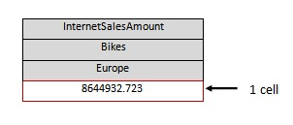
Lab
display Internet Bike sales for the "Europe" Sales Territory Group on the COLUMNS Axis.
SELECT
(
[Measures].[Internet Sales Amount]
,[Product].[Category].[Bikes]
,[Sales Territory].[Sales Territory Group].&[Europe]
)
ON COLUMNS
FROM [Adventure Works];

Slide 17
Lab
display Internet Bike sales for the "Europe" Sales Territory Group on the COLUMNS Axis.
SELECT
(
[Measures].[Internet Sales Amount]
,[Product].[Category].[Bikes]
,[Sales Territory].[Sales Territory Group].&[Europe]
)
ON COLUMNS
FROM [Adventure Works];

Slide 18
Multipart tuples
With multipart tuples, the requirements for set membership become a bit more complex. Not only must the same hierarchies be referenced between tuples, but each tuple must also reference these hierarchies in the same order as the other tuples in the set.
This requirement is referred to as shared dimensionality. The following is a valid set of multipart tuples exhibiting both shared hierarchality and shared dimensionality:
([Product]. [Category]. [Accessories], [Date]. [Calendar]. [CY 2004]), ([Product]. [Category] . [Bikes] , [Date] . [Calendar]. [CY 2002]), ([Product]. [Category]. [Clothing], [Date]. [Calendar]. [CY 20031), ([Product].[Category] .[Components], [Date].[Calendar].[CY 2001])

Slide 19
Multipart tuple example
SELECT
{
([Date].[Calendar].[CY 2005],[Geography].[Country].[United States]),
([Date].[Calendar].[CY 2006],[Geography].[Country].[United States]),
([Date].[Calendar].[CY 2007],[Geography].[Country].[United States])
} ON COLUMNS,
{
([Product].[Category].[Accessories]),
([Product].[Category].[Bikes]),
([Product].[Category].[Clothing]),
([Product].[Category].[Components])
} ON ROWS
FROM [Adventure Works]

Slide 20
Is it valid tuple ?
SELECT
{
([Date].[Calendar].[CY 2005],[Geography].[Country].[United States]),
([Date].[Calendar].[CY 2006],[Geography].[Country].[United States]),
([Date].[Calendar].[CY 2007],[Geography].[Country].[United States])
} ON COLUMNS,
{
([Product].[Category].[Accessories]),
([Product].[Category].[Bikes]),
([Product].[Category].[Clothing]),
([Product].[Subcategory].&[Helmets])
} ON ROWS
FROM [Adventure Works]

